Slide 1
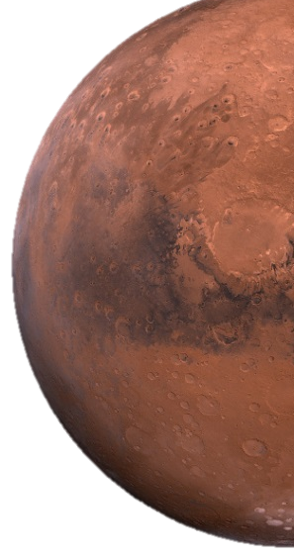


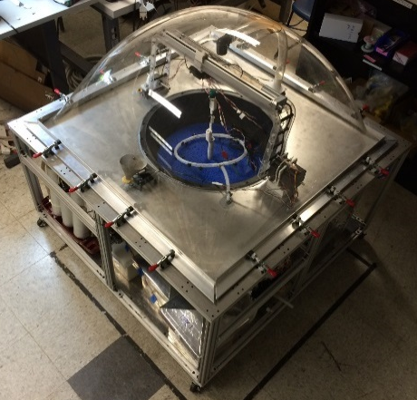
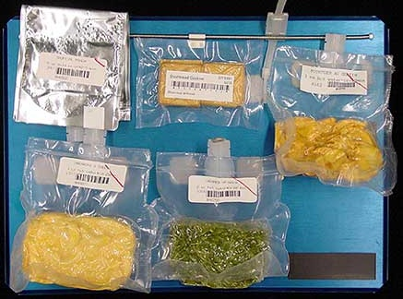
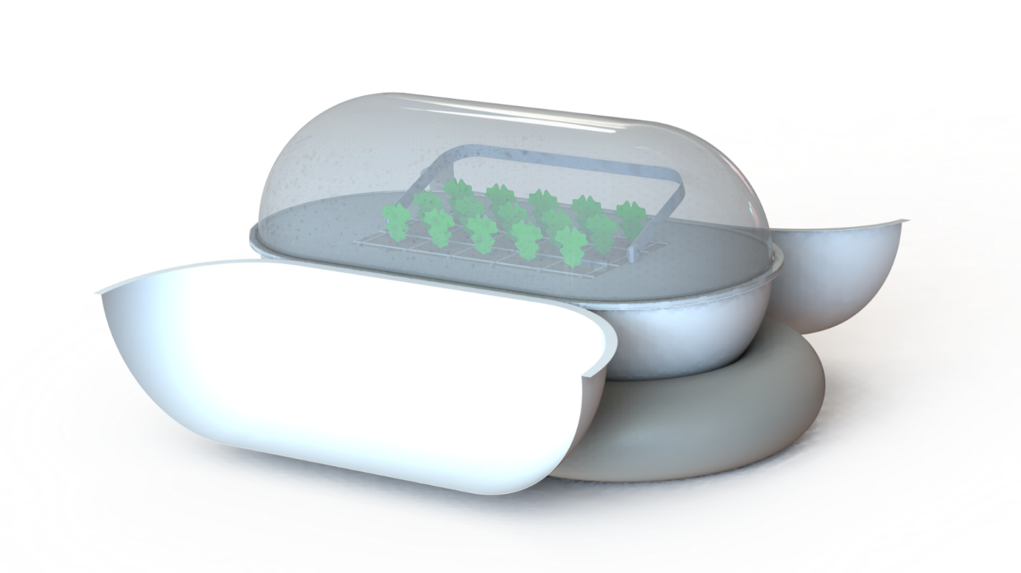
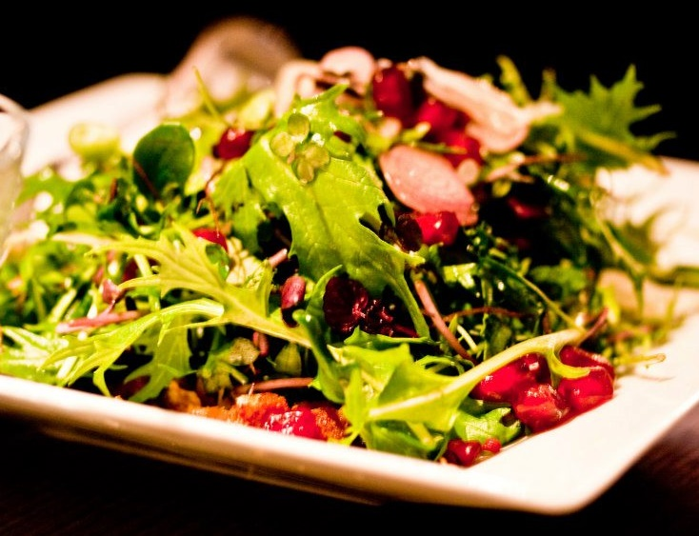


Mars Operational Agricultural System for In-Situ Specialization
A Pre-deployable Miniature Martian Greenhouse for Crop Production Research
Stabilized Packaged Food for Short Missions
PROTOTYPE
Regenerative Food for Habitation
DESIGN CONCEPT

Slide 2

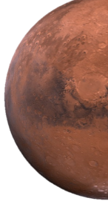

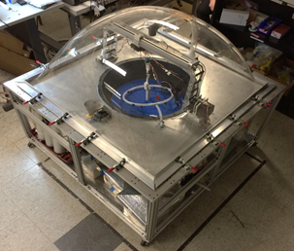
Prototype Overview
Structure: Sub-system support, moveable camera/LED mount, low leak rate vessel (2’ diameter growth area with max height of 20”) on castors, transparent dome
Nutrient & Water Manaement: Hydroponic ebb and flow system; closed , thermally controlled, water loop with air bubblers and tank circulation
Lighting: Hybrid sources with simulated in-situ light and white LEDs on a moveable bracket
Atmospheric Management: Ambient pressure (12.1 psi) with flight gas composition, CO2 injection from external tanks, O2 removal, humidity control, and air circulation
Thermal Control: Water chilling and heating (passive), humidification (active )
Data Processing and Control: autonomous control w/ tele-operation through web-based user interface and BeagleBone microprocessors
Power: 120V wall outlet, distributed to sub-systems
Scope: Autonomously provide water, nutrients, light, and atmosphere for one growth cycle of Outredgeous Lettuce, with tele-operation capability

Slide 3
2015-2016 Project Goals
The MarsOASIS system prototype is intended to be used and enhanced by the University of Colorado Bioastronautics program to further develop the technology needed to enable sustained human presence in space.
Test and characterize system performance
Identify and design prototype enhancements, including
Support of multiple crop types
Improved user interface, data transfer, and control logic
Improved performance measurement capability
(exhaust analysis, biomass, spectral analysis, etc)
Implement and verify prototype modifications
Incorporate lessons learned into updated conceptual design

